Slide 1
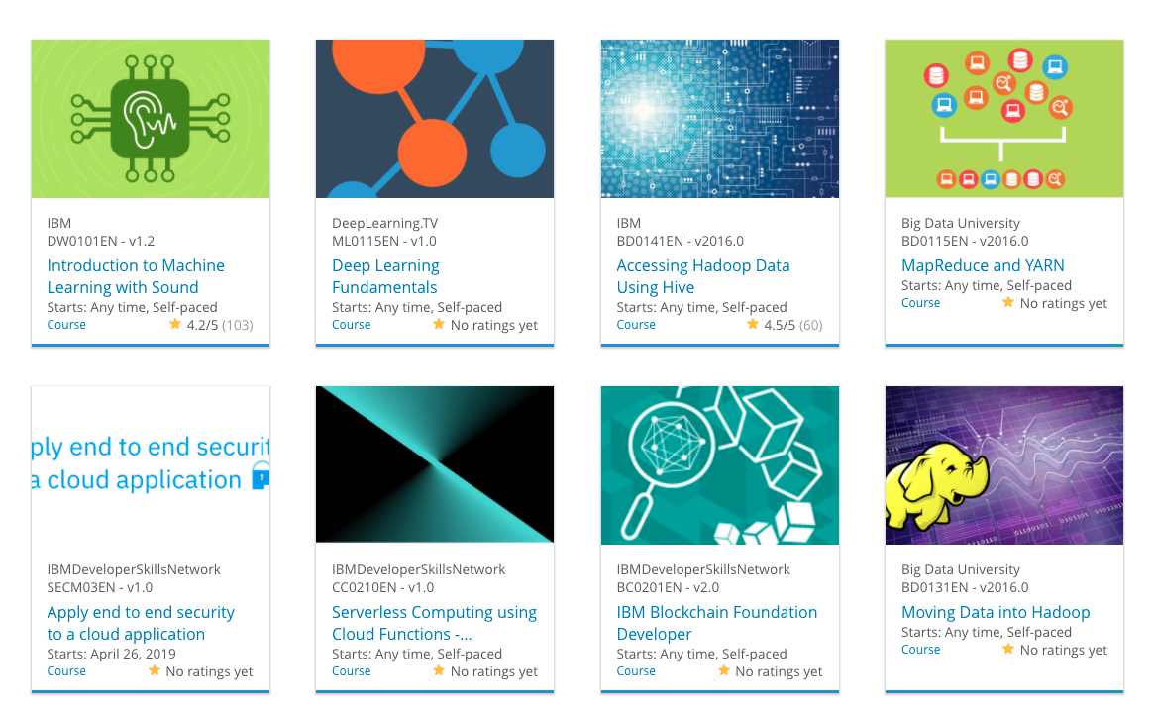

Build a Personalized Online Course Recommender System with Machine Learning
Nikhil Sharma
22/04/23

Slide 2

Outline
Introduction and Background
Exploratory Data Analysis
Content-based Recommender System using Unsupervised Learning
Collaborative-filtering based Recommender System using Supervised learning
Conclusion
Appendix

Slide 3
Introduction
Project background and context
In AI Training Room, learners from all over the world can learn various technologies such as Machine Learning, AI, Data Science, Cloud, and App development. The company's rapid growth has increased the number of courses and learners, which makes it harder for learners to find new interesting courses and create a personalized learning path. Thus, this project aims to build a recommender system that helps learners discover new courses that match their interests and better pave their learning paths.
Problem states and hypotheses
The main problem addressed in this project is the difficulty for learners to discover new courses that fit their interests and to create a personalized learning path due to the increasing number of courses and learners. Our hypothesis is that building a personalized recommender system based on course content and learners' previous interactions with courses can help learners discover new courses of interest and facilitate their learning paths. We will explore and compare various unsupervised and supervised machine learning models to find the best performing model for this task.

Slide 4

Exploratory Data Analysis

Slide 5
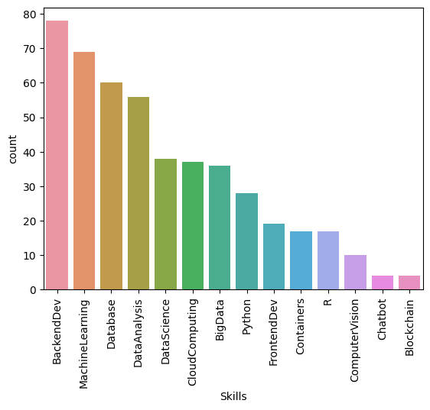
Course counts per genre
Genre | Count
BackendDev | 78
MachineLearning | 69
Database | 60
DataAnalysis | 56
DataScience | 38
CloudComputing | 37
BigData | 36
Python | 28
FrontendDev | 19
Containers | 17
R | 17
ComputerVision | 10
Chatbot | 4
Blockchain | 4

Slide 6
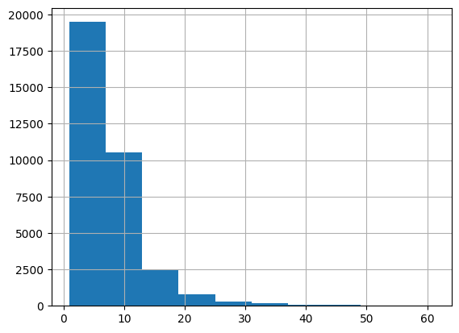
Course enrollment distribution
We have 233306 enrollments
The histogram shows the enrolment distributions, e.g., how many users rated just 1 item or how many rated 10 items, etc.

Slide 7
20 most popular courses
ID | Enrolls | TITLE
DS0301EN | 3624 | data privacy fundamentals
BD0115EN | 3670 | mapreduce and yarn
DB0101EN | 3697 | sql and relational databases 101
CO0101EN | 4480 | docker essentials a developer introduction
CC0101EN | 4983 | introduction to cloud
ST0101EN | 5015 | statistics 101
RP0101EN | 5237 | r for data science
CB0103EN | 5512 | build your own chatbot
ML0115EN | 6323 | deep learning 101
DV0101EN | 6709 | data visualization with python
BC0101EN | 6719 | blockchain essentials
DS0105EN | 7199 | data science hands on with open source tools
BD0211EN | 7551 | spark fundamentals i
ML0101ENv3 | 7644 | machine learning with python
DS0103EN | 7719 | data science methodology
DA0101EN | 8303 | data analysis with python
BD0111EN | 10599 | hadoop 101
BD0101EN | 13291 | big data 101
DS0101EN | 14477 | introduction to data science
PY0101EN | 14936 | python for data science
Used Pandas groupby() and size() methods on the item column to aggregate the rating count for each item, then use the sort_values() method to sort the course enrollment count, and use the slice method to get the top 20 courses.

Slide 8
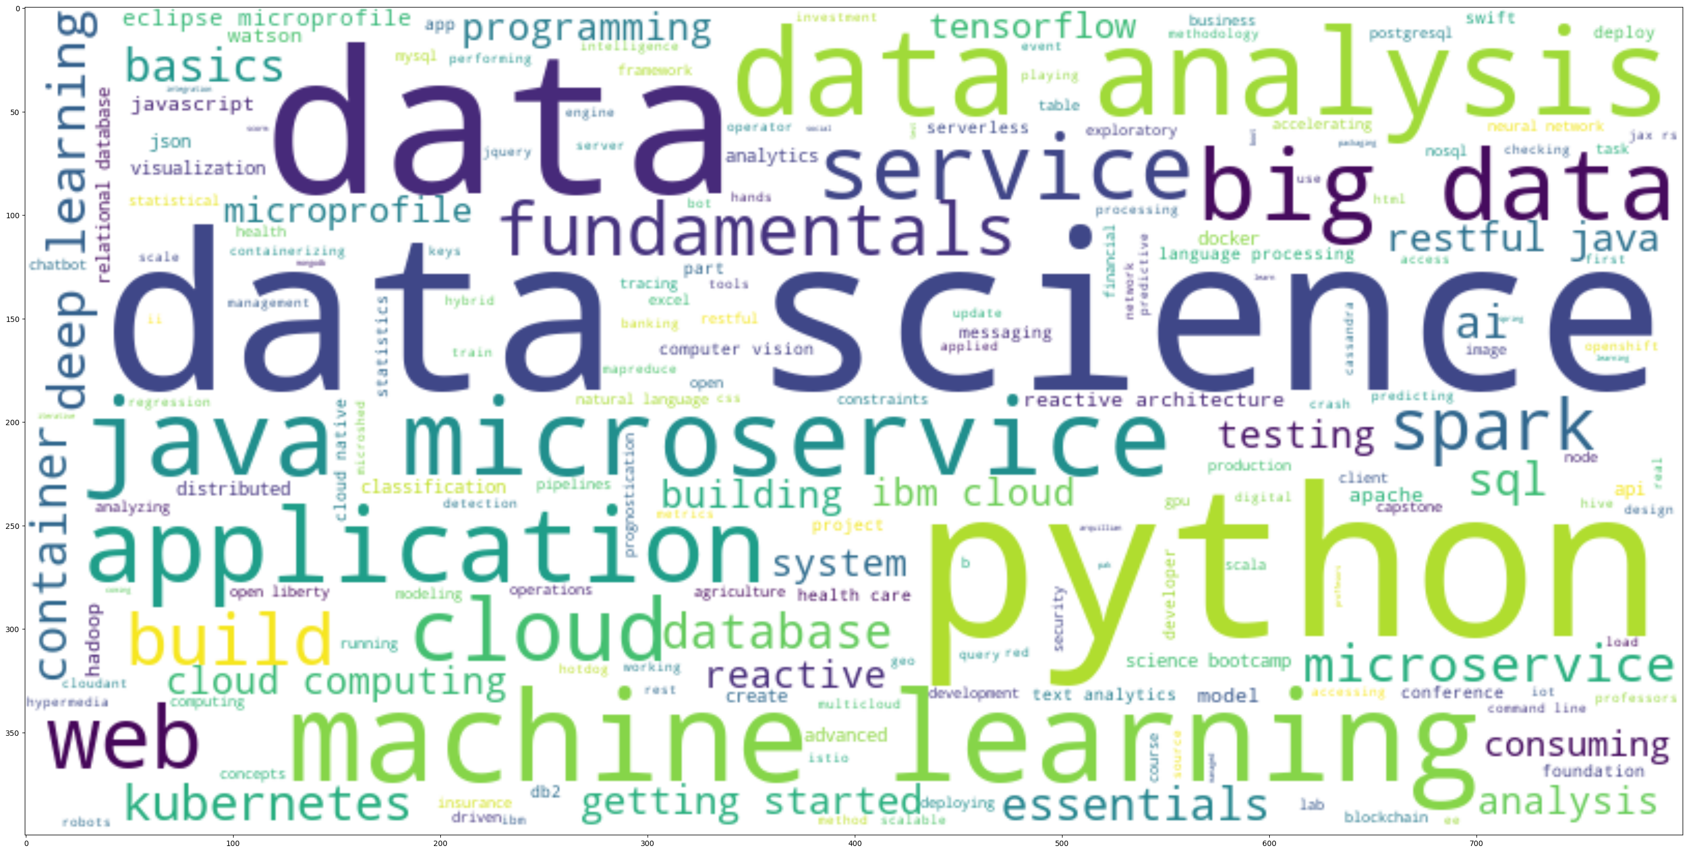
Word cloud of course titles

Slide 9
Content-based Recommender System using Unsupervised Learning
Cluster2
Cluster1

Slide 10
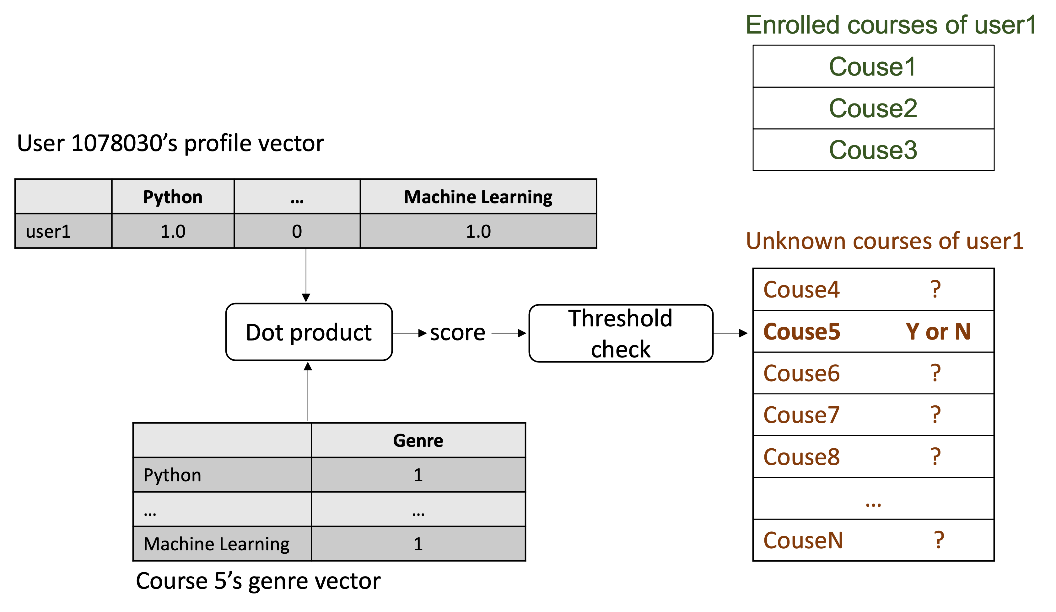
Flowchart of content-based recommender system using user profile and course genres

Slide 11
Evaluation results of user profile-based recommender system
# The threshold can be fine-tuned to adjust the size of generated recommendations
score_threshold = 10.0
On average, 61 courses have been recommended per user
Top-10 commonly recommended courses across all users
Course | Times recommended
TA0106EN | 608
GPXX0IBEN | 548
excourse22 | 547
excourse21 | 547
ML0122EN | 544
excourse04 | 533
GPXX0TY1EN | 533
excourse06 | 533
excourse31 | 524
excourse73 | 516

Slide 12
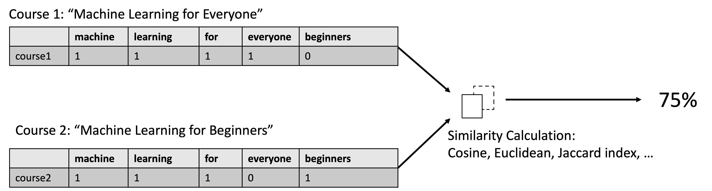
Flowchart of content-based recommender system using course similarity

Slide 13
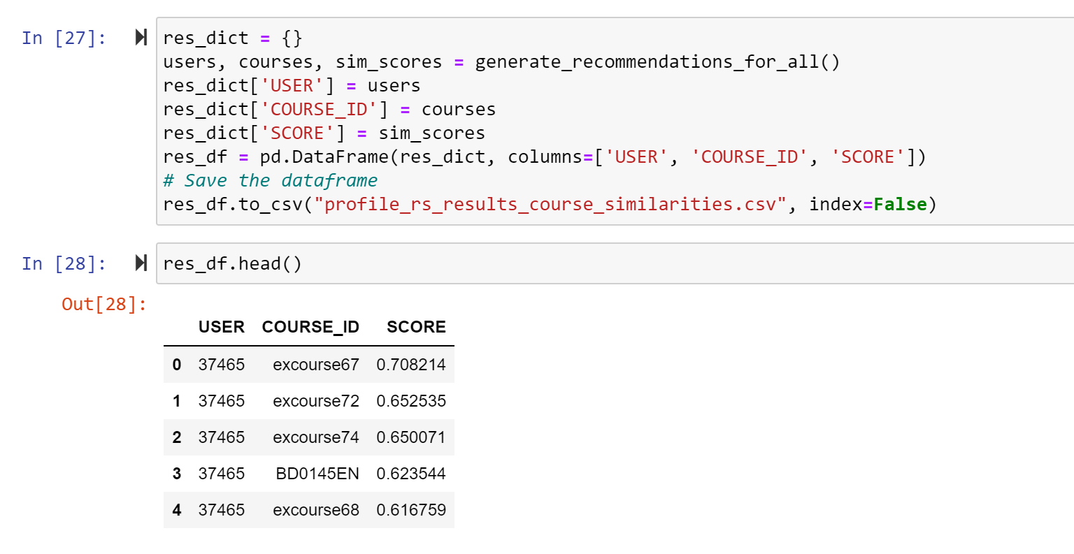
Evaluation results of course similarity based recommender system

Slide 14
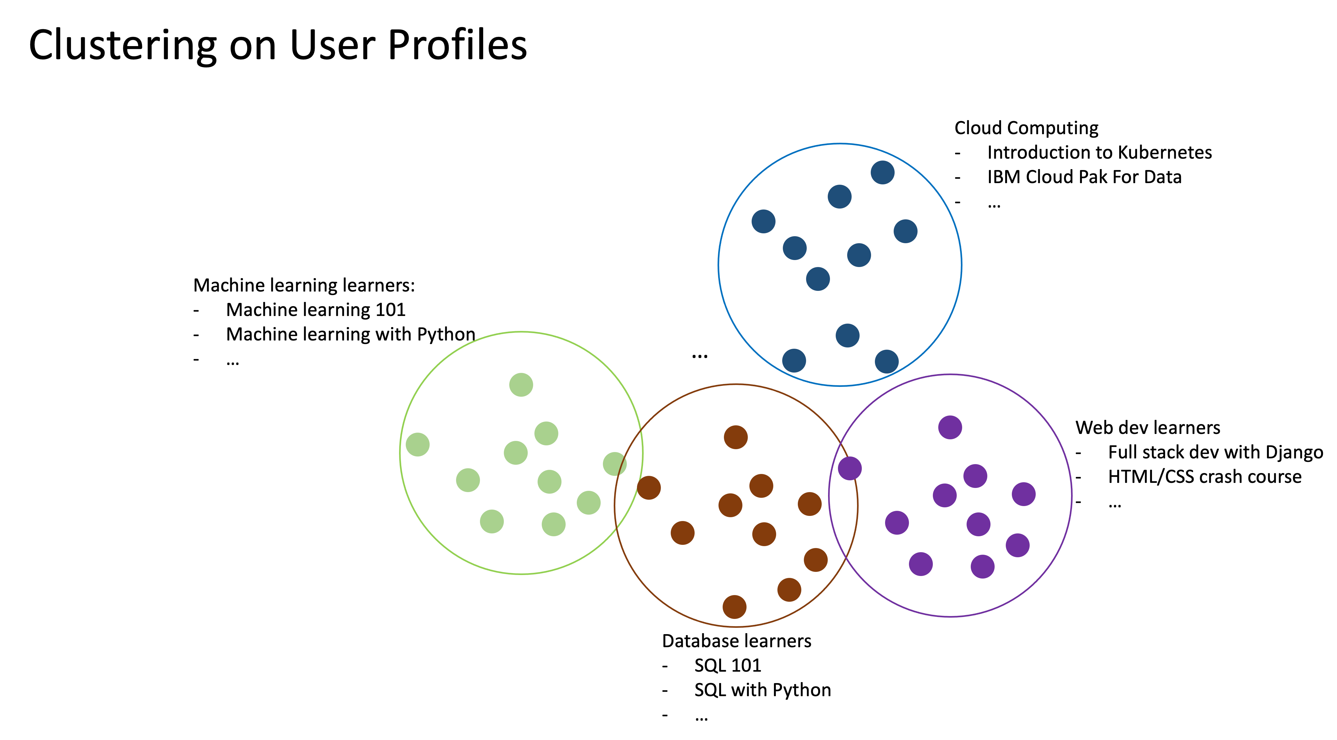
Flowchart of clustering-based recommender system

Slide 15
Evaluation results of clustering-based recommender system
user in cluster 0 will be sugessted 3 courses as ['PY0101EN' 'CB0103EN' 'DA0101EN']
user in cluster 1 will be sugessted 3 courses as ['DS0101EN' 'BD0101EN' 'PY0101EN']
user in cluster 2 will be sugessted 3 courses as ['CO0301EN' 'CO0201EN' 'BC0101EN']
user in cluster 3 will be sugessted 3 courses as ['PY0101EN' 'ML0101ENv3' 'ML0115EN']
user in cluster 4 will be sugessted 3 courses as ['BD0111EN' 'BD0141EN' 'BD0115EN']
user in cluster 5 will be sugessted 3 courses as ['CB0103EN' 'DS0101EN' 'BD0101EN']
user in cluster 6 will be sugessted 3 courses as ['CO0101EN' 'CO0201EN' 'CO0301EN']
user in cluster 7 will be sugessted 3 courses as []
user in cluster 8 will be sugessted 3 courses as ['CO0101EN' 'PY0101EN' 'CC0101EN']
user in cluster 9 will be sugessted 3 courses as ['DS0101EN' 'RP0101EN' 'DS0103EN']
user in cluster 10 will be sugessted 3 courses as ['CO0101EN' 'LB0101ENv1' 'CO0401EN']
user in cluster 11 will be sugessted 3 courses as ['RP0101EN' 'DS0101EN' 'DS0103EN']

Slide 16
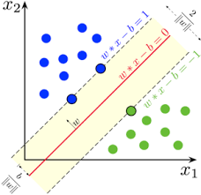
Collaborative-filtering Recommender System using Supervised Learning

Slide 17
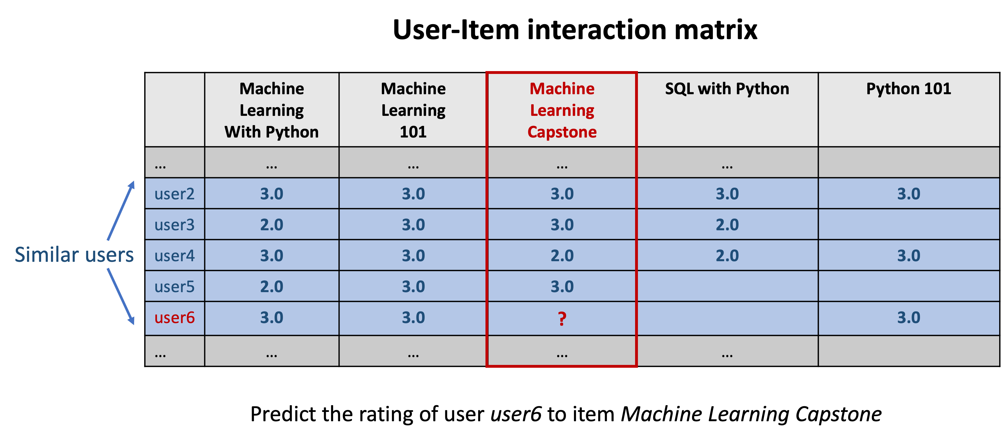
Flowchart of KNN based recommender system

Slide 18
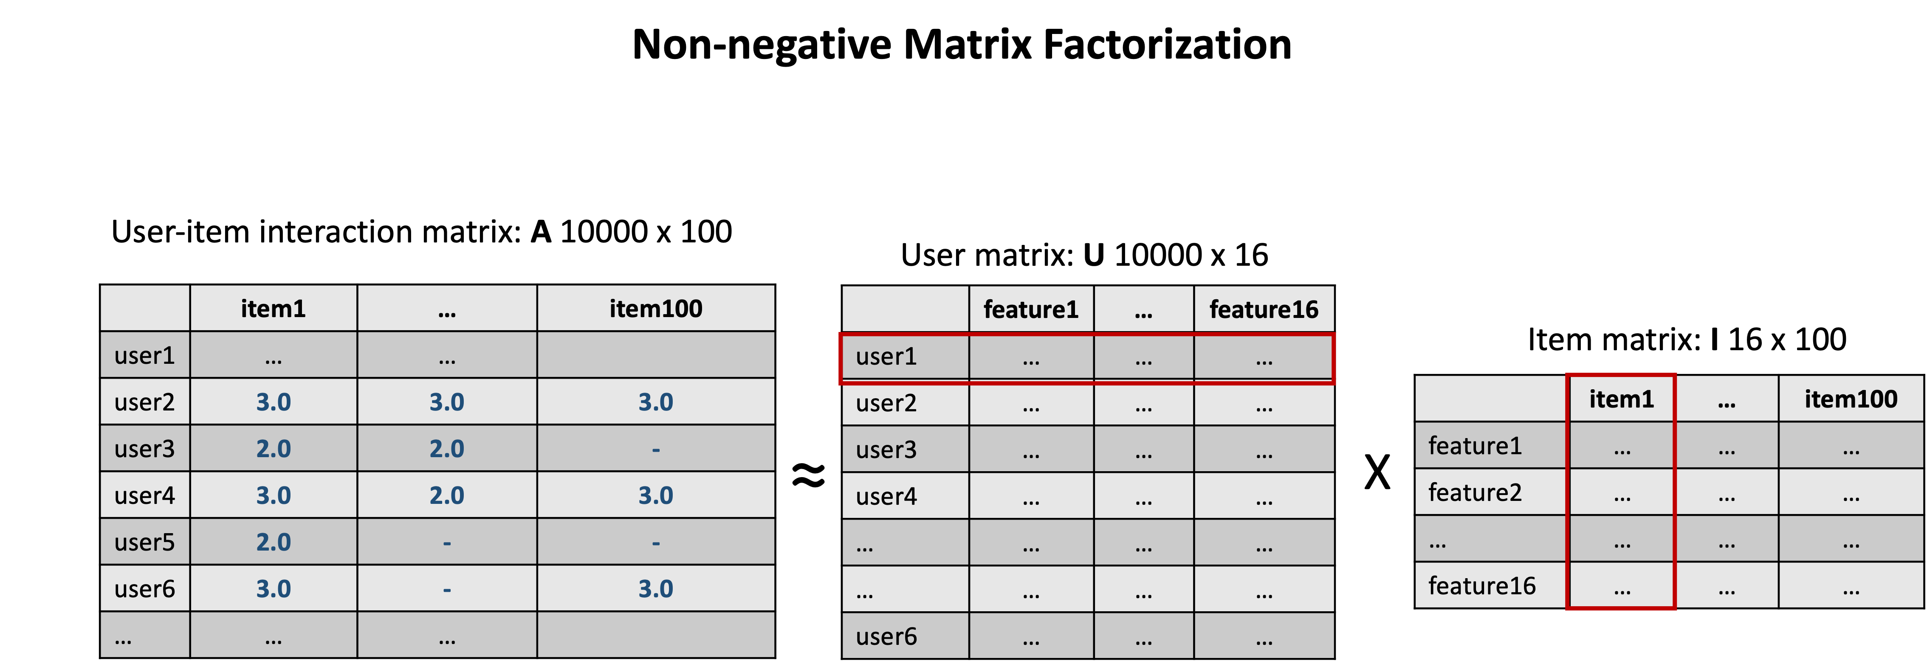
Flowchart of NMF based recommender system

Slide 19
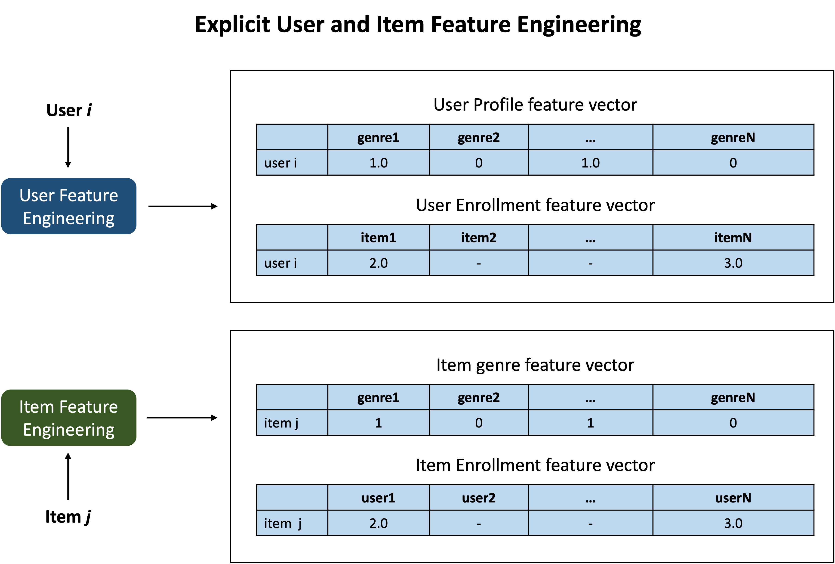
Flowchart of Neural Network Embedding based recommender system

Slide 20
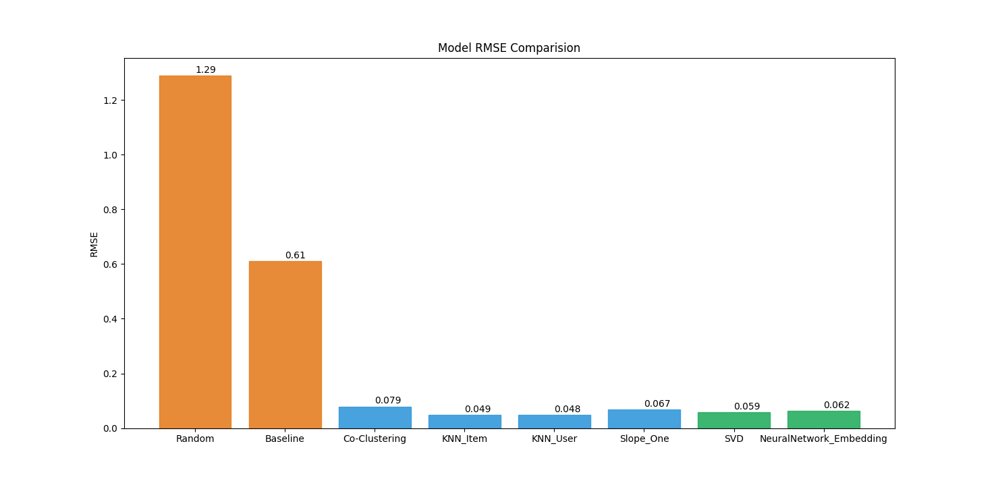
Compare the performance of collaborative-filtering models
Visualization of the performance metric (such as RMSE) of different collaborative-filtering models built so far

Slide 21
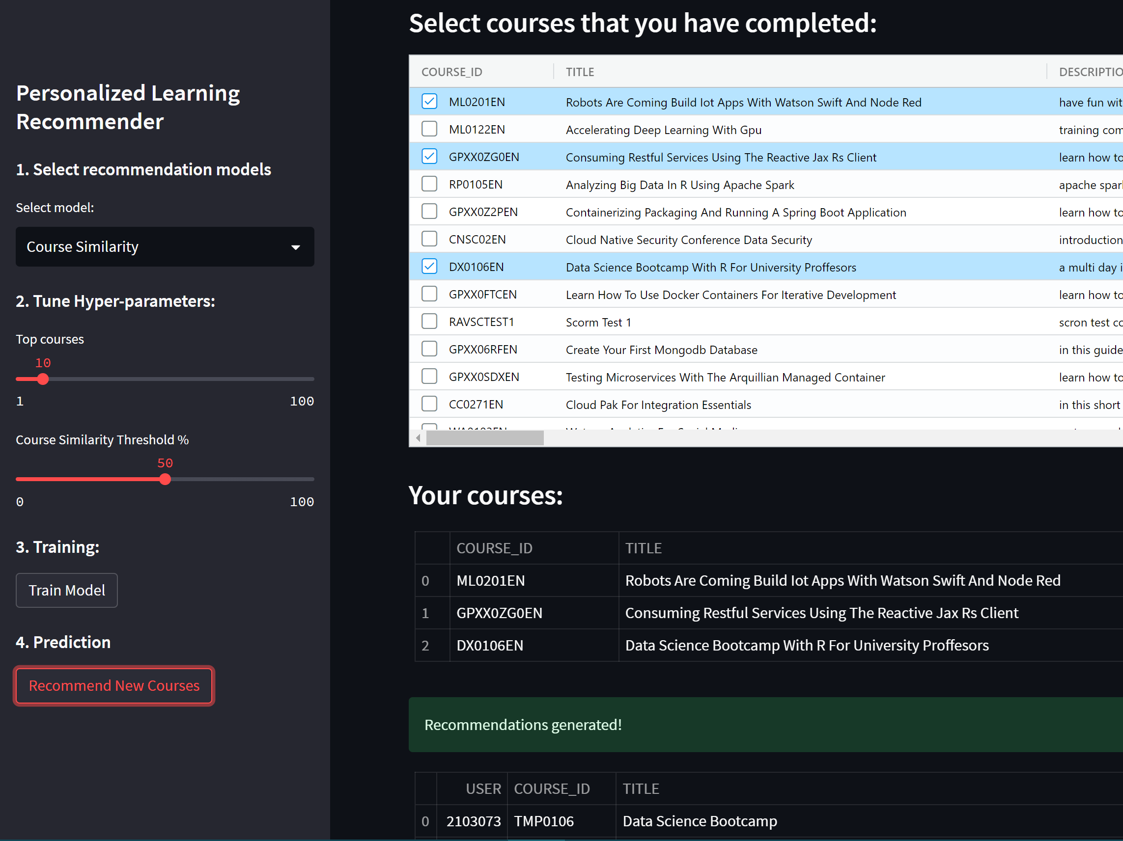
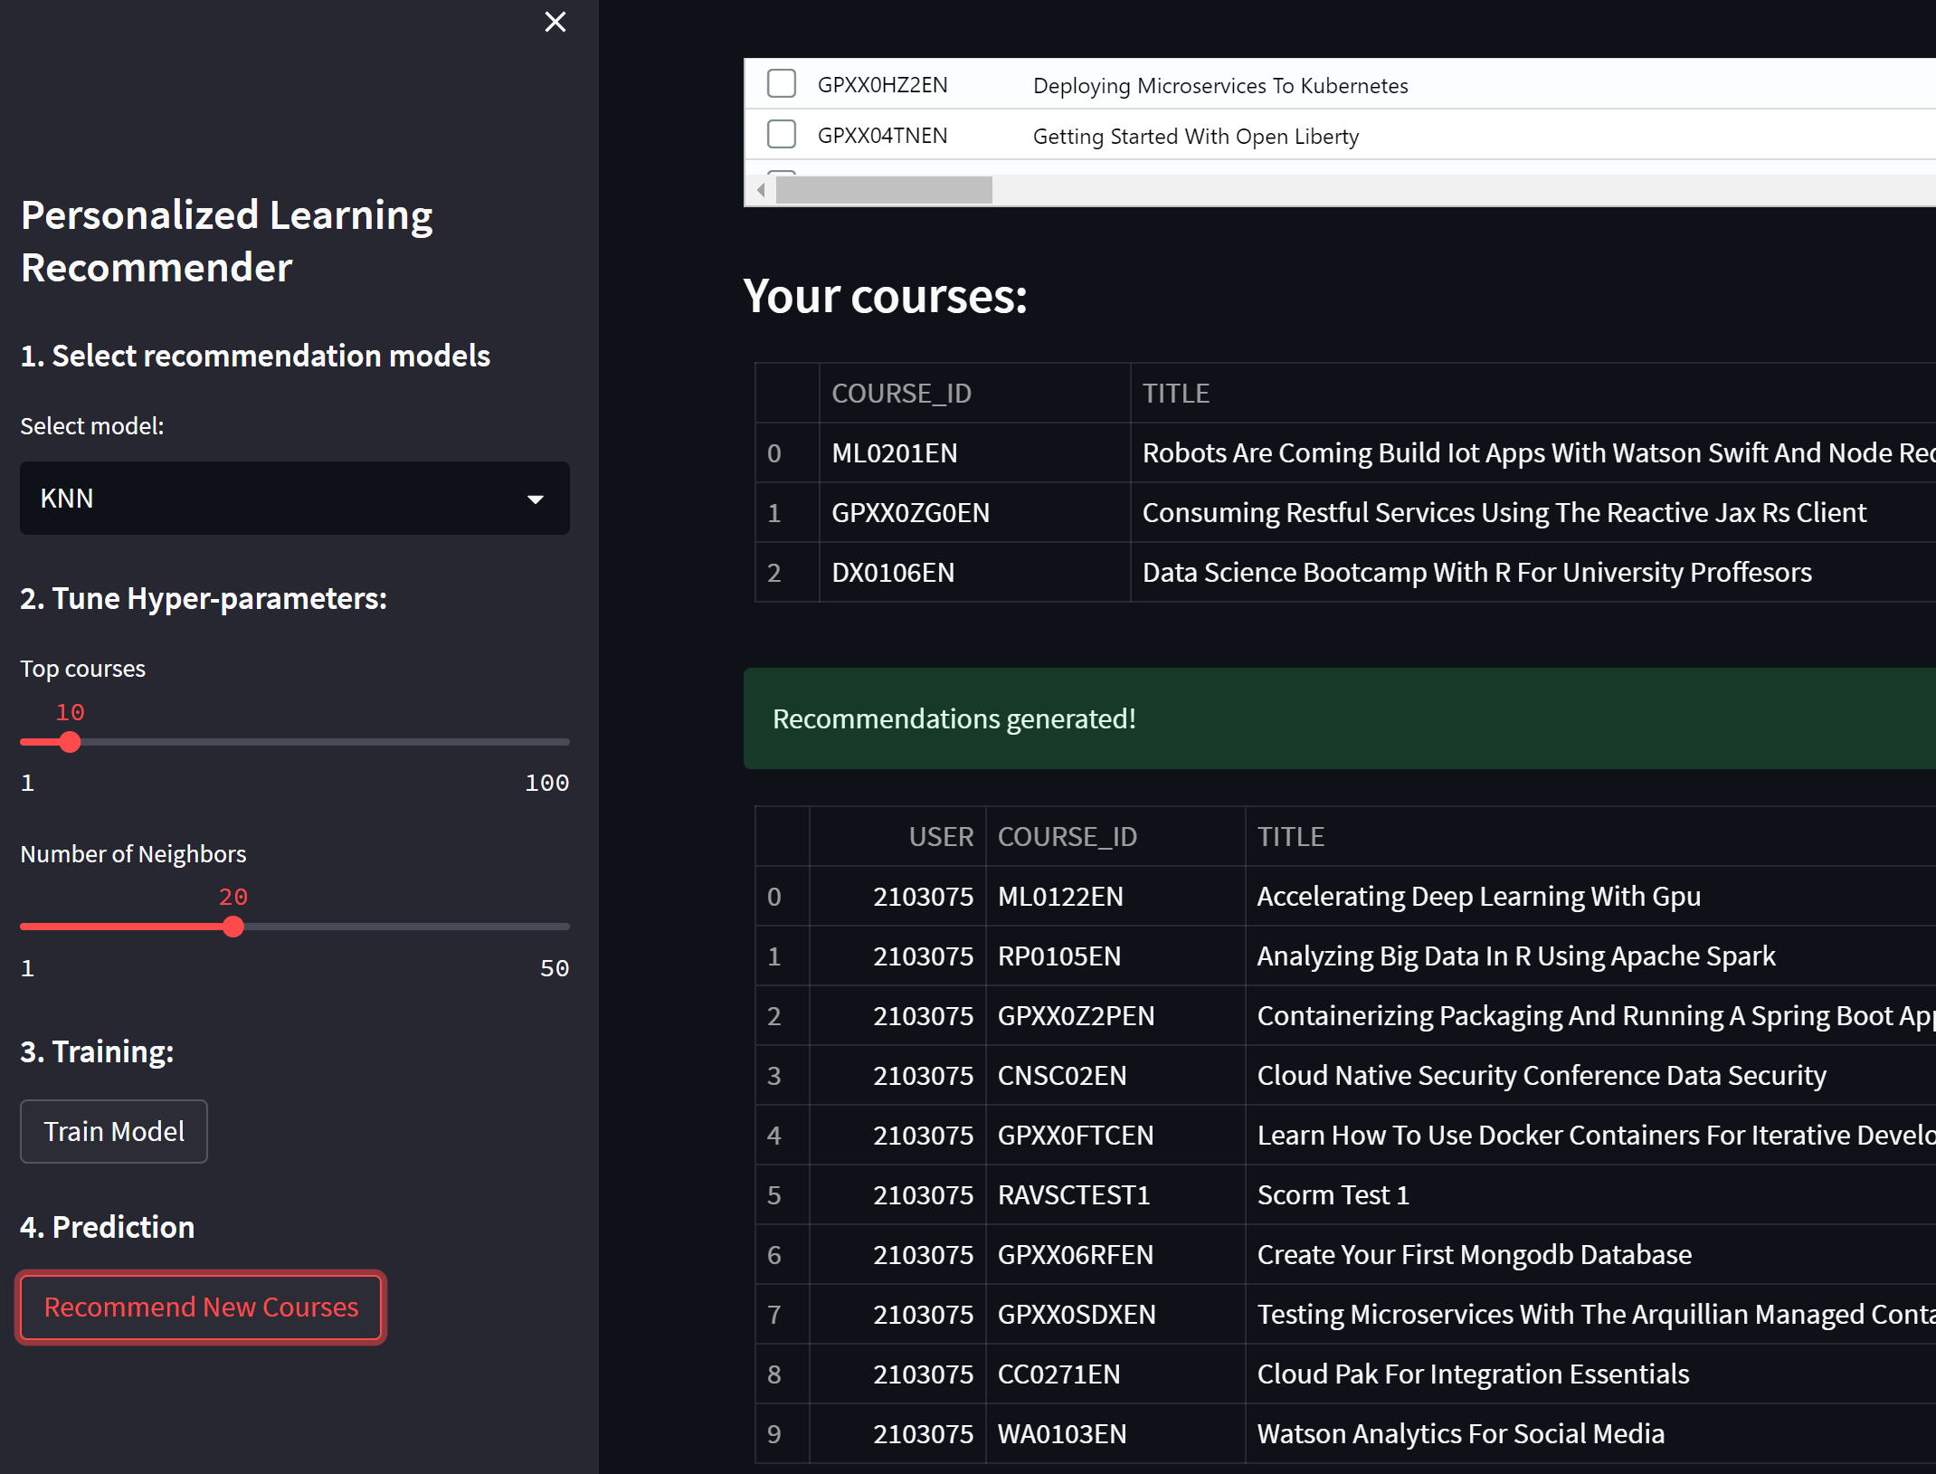
Optional: Build a course recommender system app with Streamlit

Slide 22
Conclusions
Analyzing Exploratory Data
The construction of a Recommender system that utilizes collaborative filtering and supervised learning techniques.
Building Recommender system based on collaborative filtering and supervised learning
We can attract more students and improve their learning experience by facilitating the discovery of new, captivating courses and optimizing their learning paths.
The increased usage of my recommender systems by students to engage with a wider range of courses will result in a rise in revenue for Coursera.

Slide 23
Appendix
IBM Machine Learning Professional Certificate https://www.coursera.org/professional-certificates/ibm-machine-learning
My Github https://github.com/mboccenti/Recommender_system_project

